Slide 1
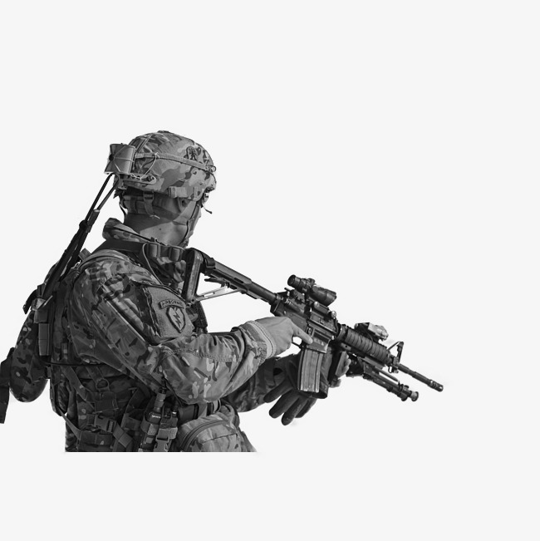

75TH INNOVATION COMMAND

Slide 2
75IC Goals for HoH
Increase Understanding
Enable, Encourage, and Enhance Collaboration
Promote Multi-level Dialogue

Slide 3
The Key Words for the 75IC are “Bridging” & “Synergy”
How will we measure success?
  Answer → Capabilities in the Hands of the Soldiers
Who needs to be part of our Innovative Ecosystem Team?
  Answer → Academia, whole of Government, big and small Business
  Small companies can be innovative, but the large companies bring scope and scale

Slide 4



WHY THE 75IC?
UNIQUE CAPABILITY FOR ARMY FUTURES COMMAND
Soldiers First
75IC members are part of the total force, with many unit members having deployed multiple times in support of OIF/OEF.
Citizens Always
75IC members provide an enduring relationship with the civilian innovation community, with unit members able to provide value through their longstanding civilian careers, contacts, and capabilities.
Innovators Immediately
75IC members provide the US Army with instant access to elusive civilian-honed knowledge, skills, abilities, and networks across a wide geographic footprint and a myriad of functional areas.

Slide 5







Task Organization – Phase I
XX
ARIC
III
III
III
III
III
I
SPT GRP
(APG)
IAAG
(Austin)
Boston Group
Austin Group
Mountain View Group
HHD
Staff
CCDC
FTAC
DET
DET
DET
DET
DET
DET
DET
DET
DET
ASA (ALT)
Portfolios
DET
DET
DET
INNOV
DET
INNOV
DET
INNOV
DET
New York City
Philadelphia
Washington DC
Atlanta
Orlando
Dallas
Chicago
Huntsville
Detroit
Minneapolis
Berkley
Los Angeles
Denver
Phoenix
Seattle
CMD
Billet

Slide 6

Selecting Great People
Experts in a Critical Area (DOTMLPF)
Self-starters, Innovators
Group Catalysts
Genuinely Care about and Like People
People first, and winning matters!

Slide 7
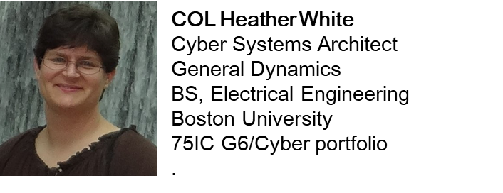

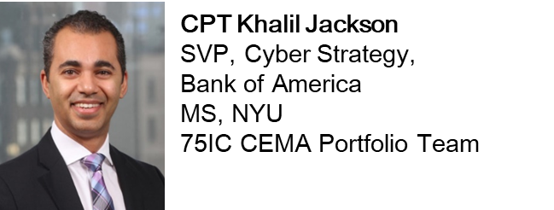
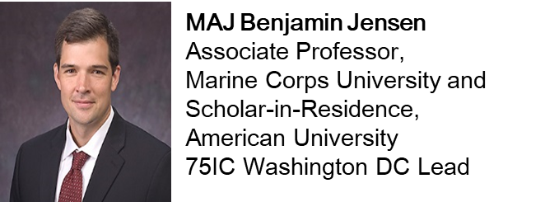
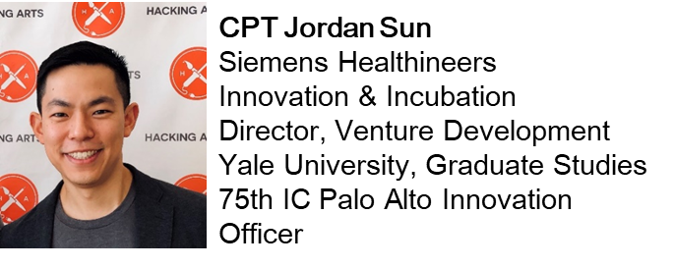
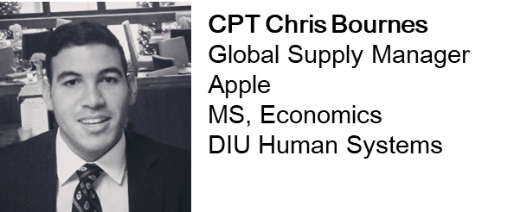

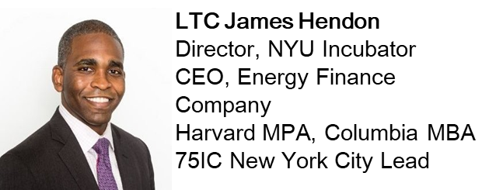
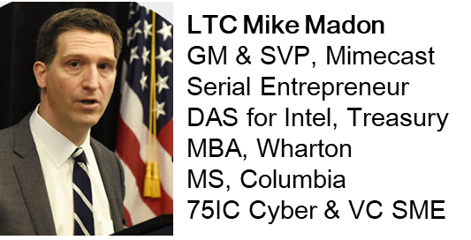
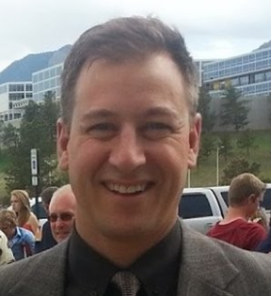
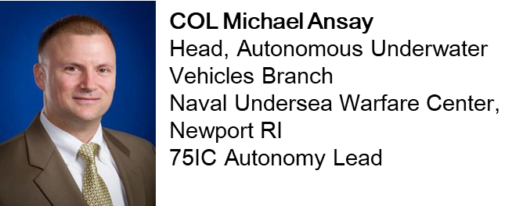
COL Belmont Miller
Space Operations SME
MA, U of Colorado
75IC Chief of Analysis

Slide 8
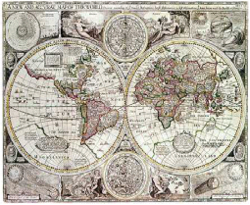
75IC Envisioned End State
A Highly Functioning, Learning Organization that makes significant, positive contributions to the Army and to the DoD:
  Demonstrably preventing strategic surprise
  Enabling the Nation to maintain asymmetric advantages
An organization that People fight to come to and leave reluctantly
An organization with a great reputation that is well respected for its value-added to the Army

Slide 9
Command Principles
Perrin Principle: be tactically and technically proficient.
  Physically and Mentally Able
  Reliability & Credibility
  Fully proficient in Army doctrine
Stafford Principle: be value-added; look for the solution that is needed, not the same as the one assigned.
  Apply your personal genius
  Challenge assumptions & constraints
  Ask the right questions
  Be creative
  Take reasonable risks
Petersen Principle: create an environment where others legitimately want to work with you
  Visualize the positive
  Units and bases are families
  Physical and mental fun
Staats Principle: reward people for jobs well-done.
  Use frequent random rewards
  Surprise those around you with positive reinforcement

Slide 10
A Word on Innovation …
Innovation = Creativity $∩$ Productivity
Creativity
Productivity

Slide 11
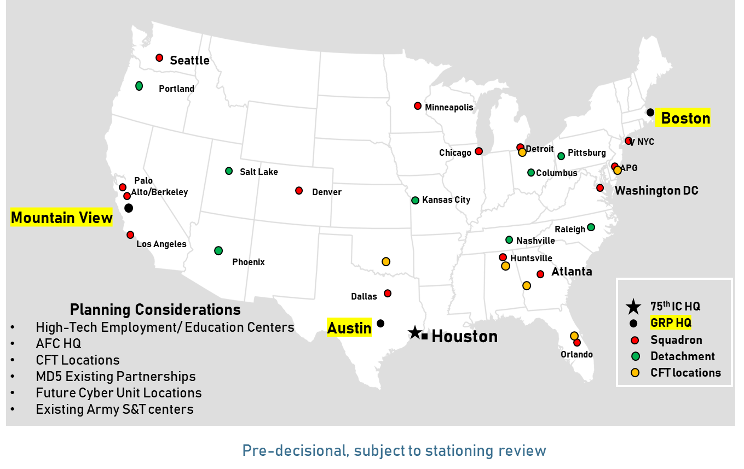
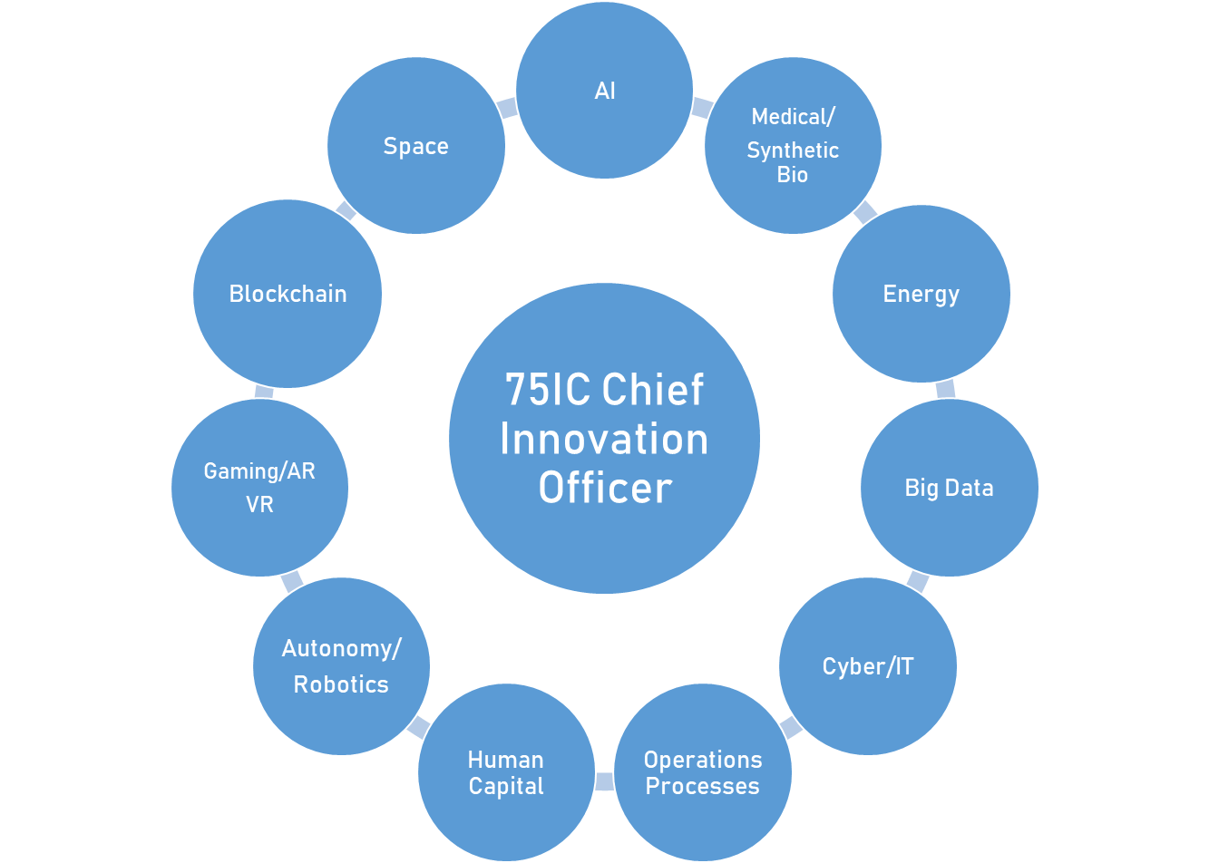
GEOGRAPHICALLY DISTRIBUTED
“TECH SCOUT” TEAMS
FUNCTIONALLY
ORGANIZED
“INNOVATION PORTFOLIO” TEAMS
3 Groups/15 Squadrons/23 Cities
Squadrons - self steering, rank/branch agnostic; cross functional talent magnets; an agile, distributed network that adds capability and capacity and expands the network
Groups understand and articulate SA/CSA priorities and technology and innovation gaps; maintain situation awareness and common operating picture with AFC
Flexible focus areas - talent and threat dependent – informed by SA/CSA priorities – adjusts as needed
The integration point for coordination with and subject matter expertise to the AFC cross functional teams
A collaborative effort with the AFC “Army Applications Lab”; likely co-located
Agile fusion cell to consolidate the crowdsourced solutions and what we are seeing – and feed to the Army

Slide 12
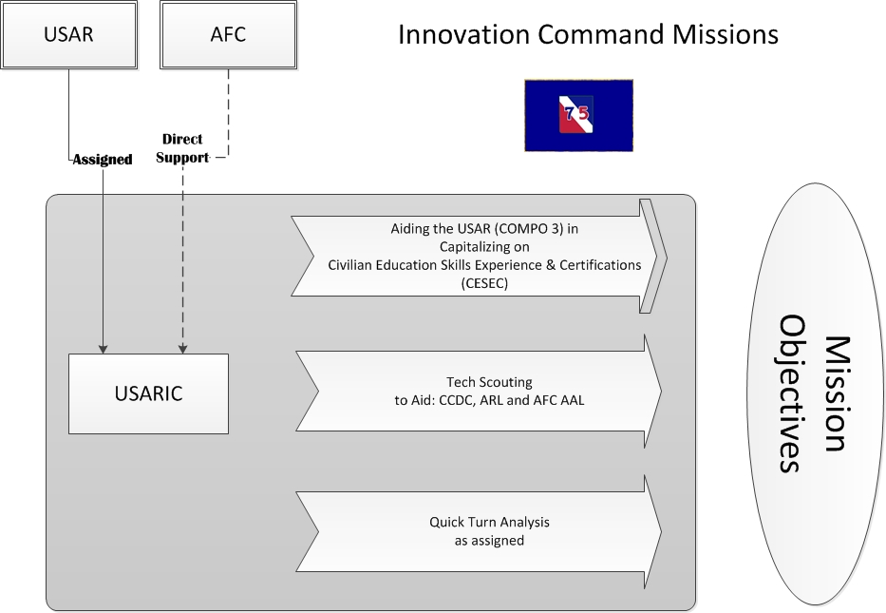
FY 20 Priority Lines of Effort

Slide 13
“Things we are proud of …”

Slide 14
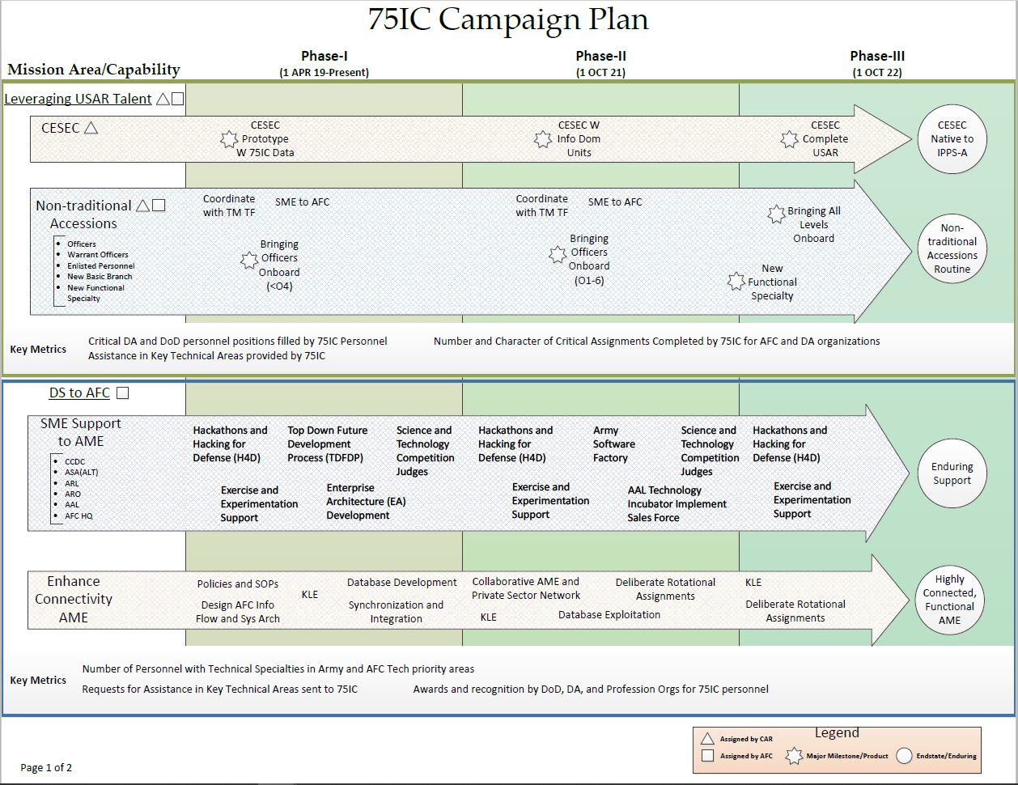

Slide 15
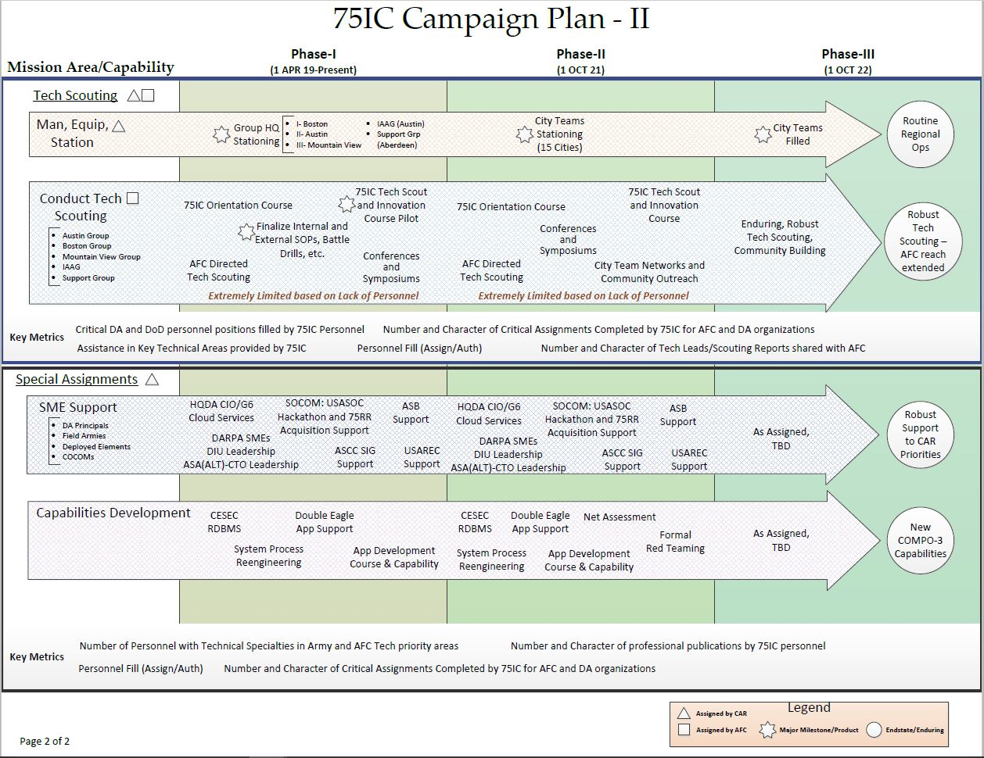

Slide 16


Never doubt that a small group of thoughtful, committed citizens can change the world. Indeed, it is the only thing that ever has.
“Earth at Omega” by Donald Keys, quoting the cultural anthropologist, Margaret Mead.
QUESTIONS?

Slide 17
Backup

Slide 18
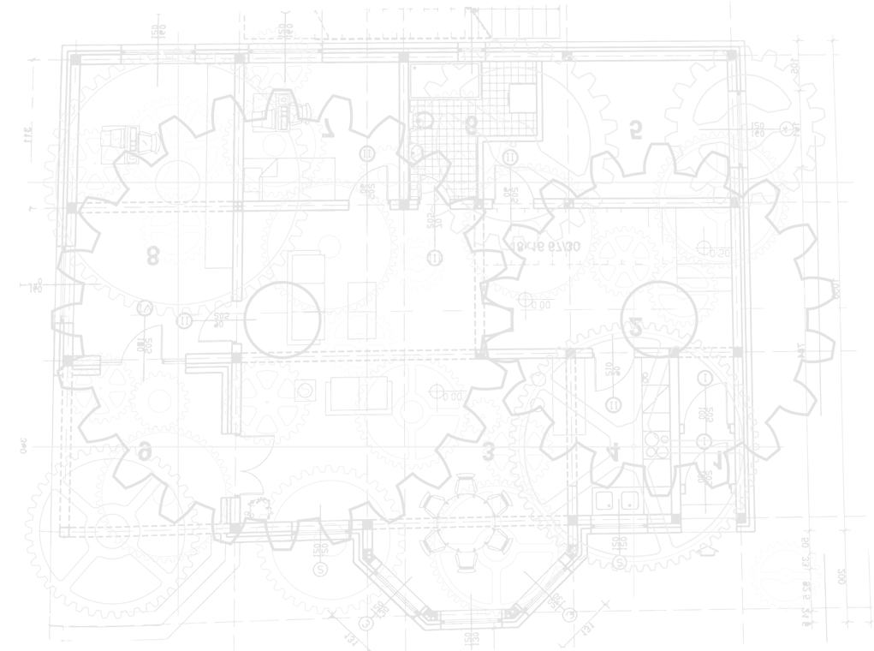
Reserve soldiers are in every sector and industry
Solution
Think tanks
Intelligence
Cyber / IT
Venture Capital
Energy
Entrepreneurs
Automation / Robotics
Space
Medical / Synthetic Bio
Legal
Gaming AR / VR
Big Data

